Slide 1
Security Tools for Information Security
ENPM 685

Slide 2
Incident Response and Investigations
(Continued)

Slide 3
Log Analysis
Challenging to do manually
What are we looking for?
Training is important
Cheat sheets can help

Slide 4
Logs All The Things!
You can’t generate logs after the fact
You need logs from hosts and network devices
Centralized remote storage is essential
Allows for easier analysis
Makes log tampering harder

Slide 5
How to approach logging
How should we approach logging/auditing given the limits on human resources, time, etc.?

Slide 6

How to approach logging

Slide 7
How to approach logging

Slide 8
How to approach logging
Log the important things
Admin/privileged users logins (especially after hours)
Regular user logins/failed logins useful too
New admin/privileged user accounts created
System/service restarts
Critical failures
Web access logs
Access to DBs w/ PII
Virus/Malware alerts on critical systems or a pattern of alerts

Slide 9
How to approach logging
Web logs (and key items to review:)
Interesting useragents (sqlmap, Python-urllib, odd user agents)
Access to web app admin consoles/portals
SQL injection attempts
XSS attempts
Things outside the norm, like requests for PHP files when you use ColdFusion

Slide 10
Unix log files of note
/var/log/auth.log OR /var/log/secure
(depends on Unix/Linux variant - console and SSH login info)
/var/log/apache/access.log and error.log
/var/log/messages OR /var/log/syslog
/var/log/btmp , utmp, wtmp – failed login history, currently logged in users, login/logout history
Binary files – read with lastb, who/w, last
Logs for specific application you are using on host (MySQL, web app specific, etc)

Slide 11
Windows log files of note
Windows Event Logs
System
Security
Application

Slide 12
How to approach logging
NTP (network time protocol) is your friend.
Sync time on your servers early and often, preferably with your own local NTP host

Slide 13
How often to review logs?
At a minimum: Weekly, daily if you can for the most important stuff:
After hours admin logins
New admin accounts created
AV notifications on key systems
System/service restarts
Log management systems or DIY scripting can assist with this by generating emails or alerts

Slide 14
How often to review logs?
Automate reporting for anomalies as much as possible!
Keep it short, sweet, simple

Slide 15
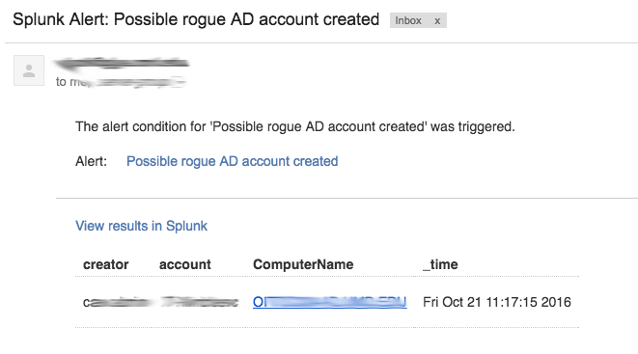
Alerting

Slide 16
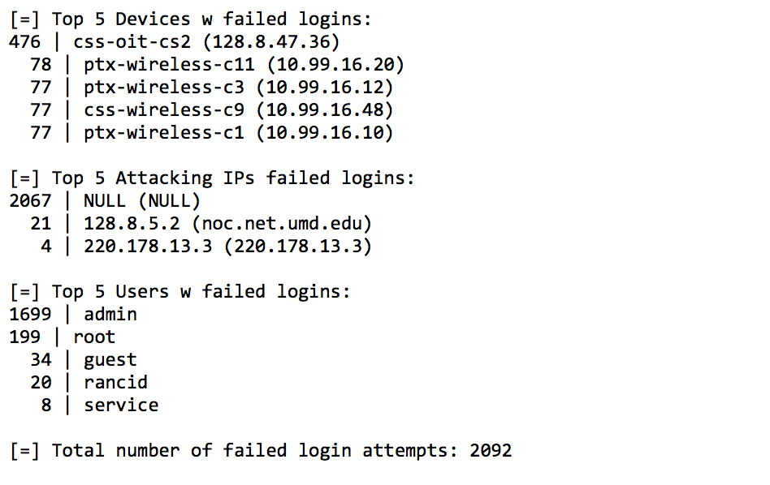
Alerting

Slide 17
Log retention policies
Enough time for them to be useful for incident response but not long enough to be discoverable in a lawsuit
30 days? 45 days? 90 days?
Exceptions
Proof of audit compliance, keep for 3 years or until next audit
Logs that must be retained for longer periods due federal mandates/legal/industry – PCI DSS, GLBA, SOX

Slide 18
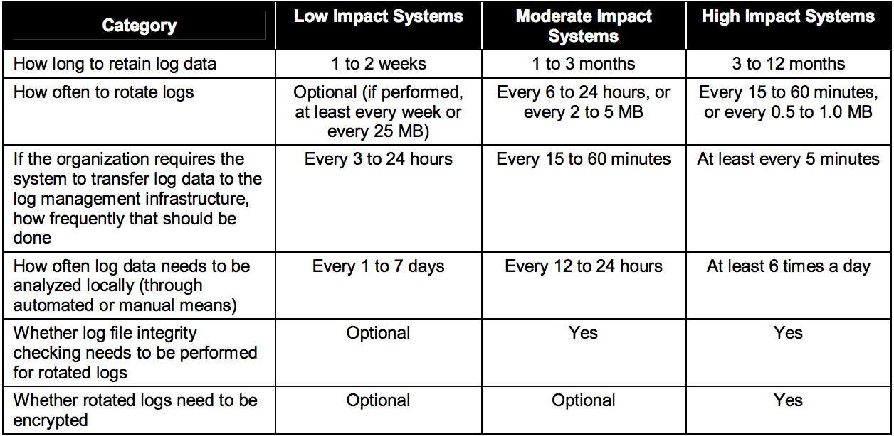
NIST stance on log policies
http://csrc.nist.gov/publications/nistpubs/800-92/SP800-92.pdf

Slide 19
Log Management
Syslog (Linux and everything else)
Windows logs
JSON
Database audit logs
Annoyingly painful custom/binary formats

Slide 20
syslog
“standard” for message logging, mostly in unix environments
Typical format:
timestamp host process message

Slide 21
syslog
By default logs locally to /var/log/
Ok that’s great but I don’t want to have to look at 500 hosts for my logs!
Build a syslog server
Syslog (via syslogd) can be set up for forward logs to an external server, over 514/UDP by default

Slide 22
syslog
Jul 25 07:05:29 solberg kernel: [UFW BLOCK] IN=eth0 OUT= MAC=00:18:8b:10:c5:68:00:08:e3:ff:fc:68:08:00 SRC=186.112.110.170 DST=128.8.103.139 LEN=56 TOS=0x08 PREC=0x40 TTL=43 ID=46312 DF PROTO=TCP SPT=47509 DPT=23 WINDOW=5440 RES=0x00 SYN URGP=0
180.76.15.32 - - [24/Jul/2016:06:48:06 -0400] "GET / HTTP/1.1" 200 456 "-" "Mozilla/5.0 (compatible; Baiduspider/2.0; +http://www.baidu.com/search/spider.html)"

Slide 23
rsyslog
A more complex version of syslogd
Highly configurable
Supports more than just syslog
MySQL, Oracle, MongoDB, etc
Supports TCP, SSL/TLS
Can filter based on syslog message
Can configure output (add/remote things)
Multi-threaded

Slide 24
rsyslog
if $programname == 'prog1' then {
action(type="omfile" file="/var/log/prog1.log")
if $msg contains 'test' then
action(type="omfile" file="/var/log/prog1test.log")
else
action(type="omfile" file="/var/log/prog1notest.log")
}

Slide 25
syslog-ng
Adds more configurability to syslog
Filtering based on message content, source, etc
Can use TCP for transport

Slide 26
syslog-ng
filter f_dhcp { match("dhcpd" value("PROGRAM")); };
destination dhcp { file(”/log/DHCP/$R_YEAR$R_MONTH$R_DAY/$R_HOUR" template("$R_DATE $HOST $MESSAGE $PID $MESSAGE\n")); };
log { source(net); filter(f_dhcp); destination(dhcp); flags(final); };

Slide 27
rsyslog vs syslog-ng
Coke vs Pepsi

Slide 28
syslog-ng
filter f_iptables { facility(kern) and message("IN=") and message("OUT=");
};
filter f_console { level(warn) and facility(kern) and not
filter(f_iptables) or level(err) and not
facility(authpriv); };
log { source(src); filter(f_console); destination(console); };
log { source(src); filter(f_console); destination(xconsole); }

Slide 29
rsyslog
if ( \
/* kernel up to warning except of firewall */ \
($syslogfacility-text == 'kern') and \
($syslogseverity <= 4 /* warning */ ) and not \
($msg contains 'IN=' and $msg contains 'OUT=') \
) or ( \
/* up to errors except of facility authpriv */ \
($syslogseverity <= 3 /* errors */ ) and not \
($syslogfacility-text == 'authpriv') \
) \
then /dev/tty10
& |/dev/xconsole

Slide 30
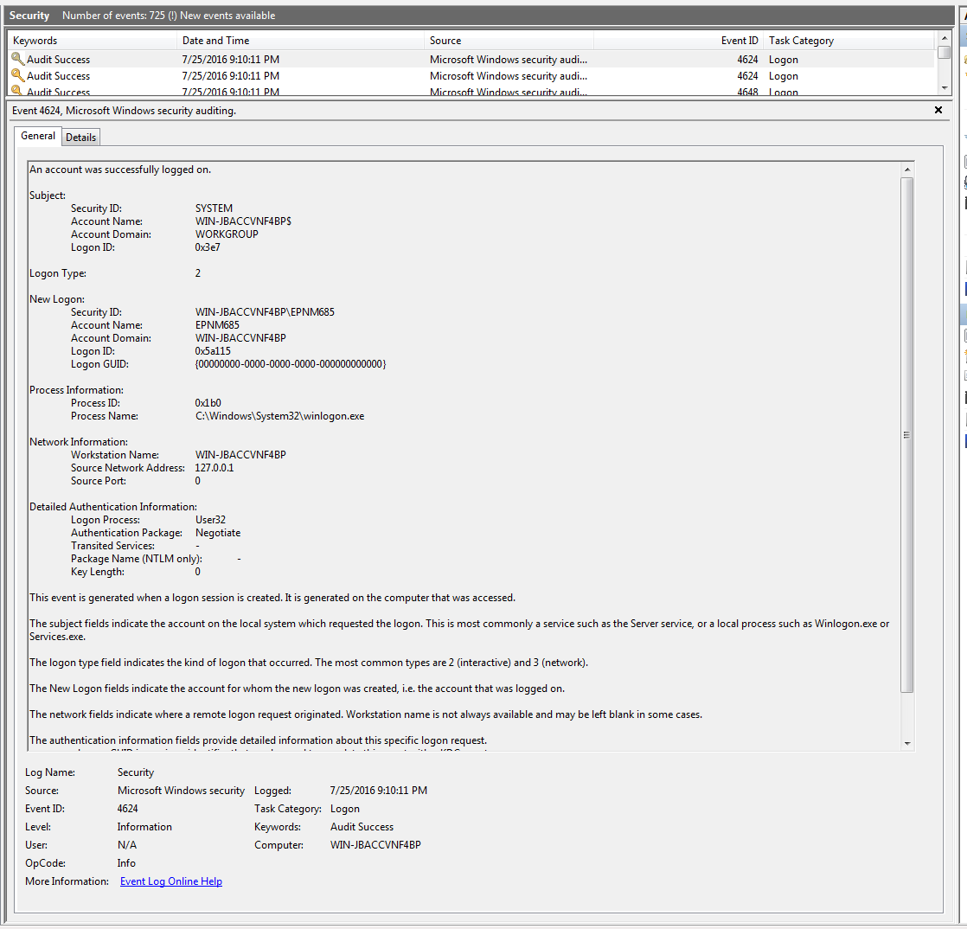
Windows Event Logs

Slide 31
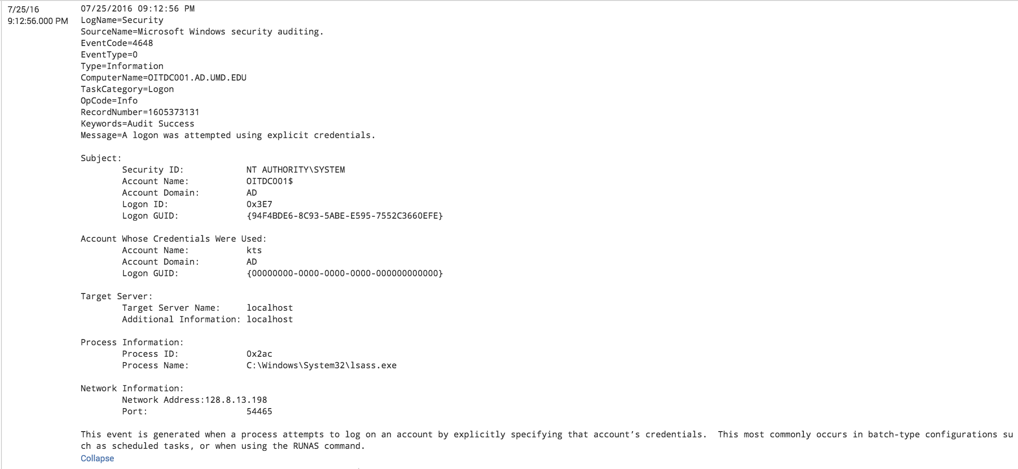
Windows Event Logs

Slide 32
JSON
JavaScript Object Notation
Open standard format for client/server communication
Attribute : value pairs
“Human readable”
Can nest attribute : value pairs, much like XML

Slide 33
JSON
{
“eventid”: 1,
“user”: “bob”,
“status”: “OK”
}

Slide 34
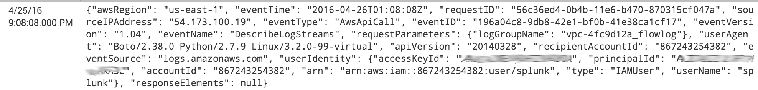
JSON

Slide 35
JSON
{"awsRegion": "us-east-1", "requestParameters": {"logGroupName": "vpc-853b08e0_flowlog"}, "requestID": "f77b5bfd-545c-11e6-9e9f-9b4788a8f1d5", "apiVersion": "20140328", "responseElements": null, "sourceIPAddress": "54.173.100.19", "eventID": "55f4781c-dea3-4aa2-b360-8b7814ed2c00", "eventSource": "logs.amazonaws.com", "recipientAccountId": "867243000000", "eventVersion": "1.04", "userAgent": "Boto/2.38.0 Python/2.7.9 Linux/3.2.0-99-virtual", "eventType": "AwsApiCall", "eventTime": "2016-07-28T00:48:14Z", "userIdentity": {"principalId": "AIDAIZZZZZS2", "userName": "splunk", "arn": "arn:aws:iam::867243000000:user/splunk", "accessKeyId": ”ZZZZ", "accountId": "867243000000", "type": "IAMUser"}, "eventName": "DescribeLogStreams"}

Slide 36
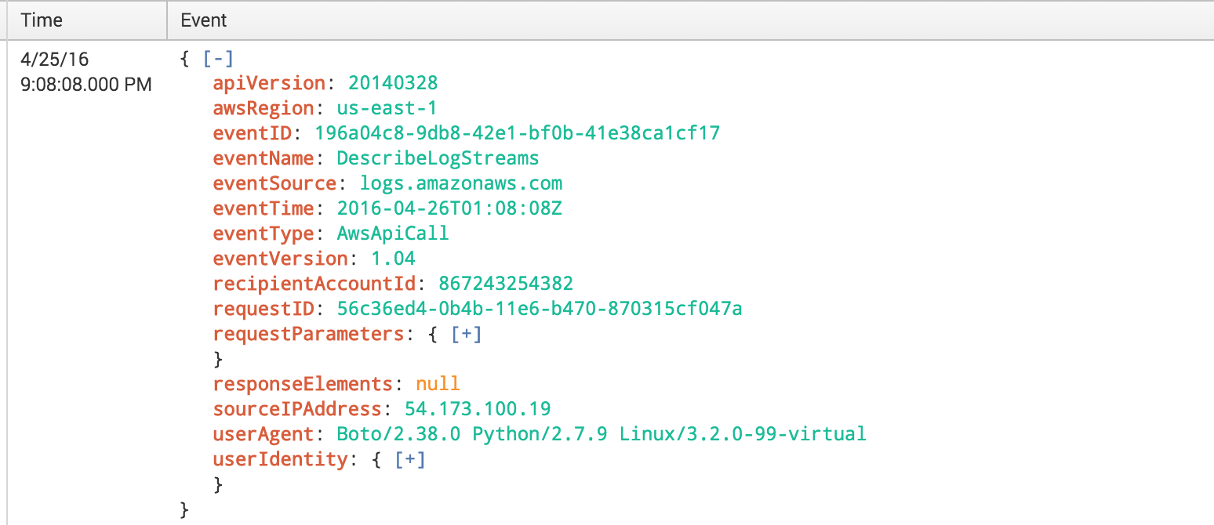
JSON

Slide 37
Log Management Tools
Splunk
Elastic (ElasticSearch/ELK)
Loggly
GreyLog
Sumo Logic
Solarwinds

Slide 38
Splunk
The forth best tool
in my toolkit

Slide 39
Best Tools
A knowledgeable user
An accurate, up to date asset inventory
?
Splunk (or any good log management tool)

Slide 40


Slide 41
Splunk
Commercial product (free version for < 500mb/day)
First released in 2004
Like Google for your log files
Huge search language to help you slice/dice logs
Can be integrated into single server (log collection/indexing, searching) or distributed across many servers
Indexer – stores logs, processes searches for search head
Search Head – slices and dices searches and distributes to indexers. Also provides presentation layer
Forwarder – agent that sends logs into Splunk
Can install “apps” to expand Splunk’s knowledge of logs as well as easily build reports
SDK to expand/integrate

Slide 42
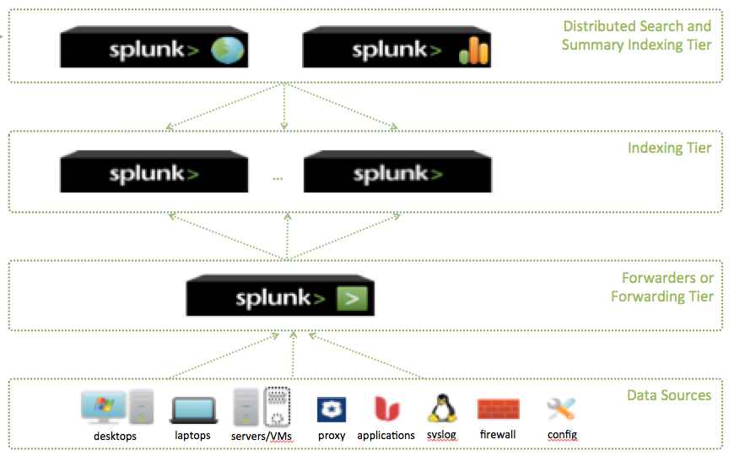
Splunk

Slide 43
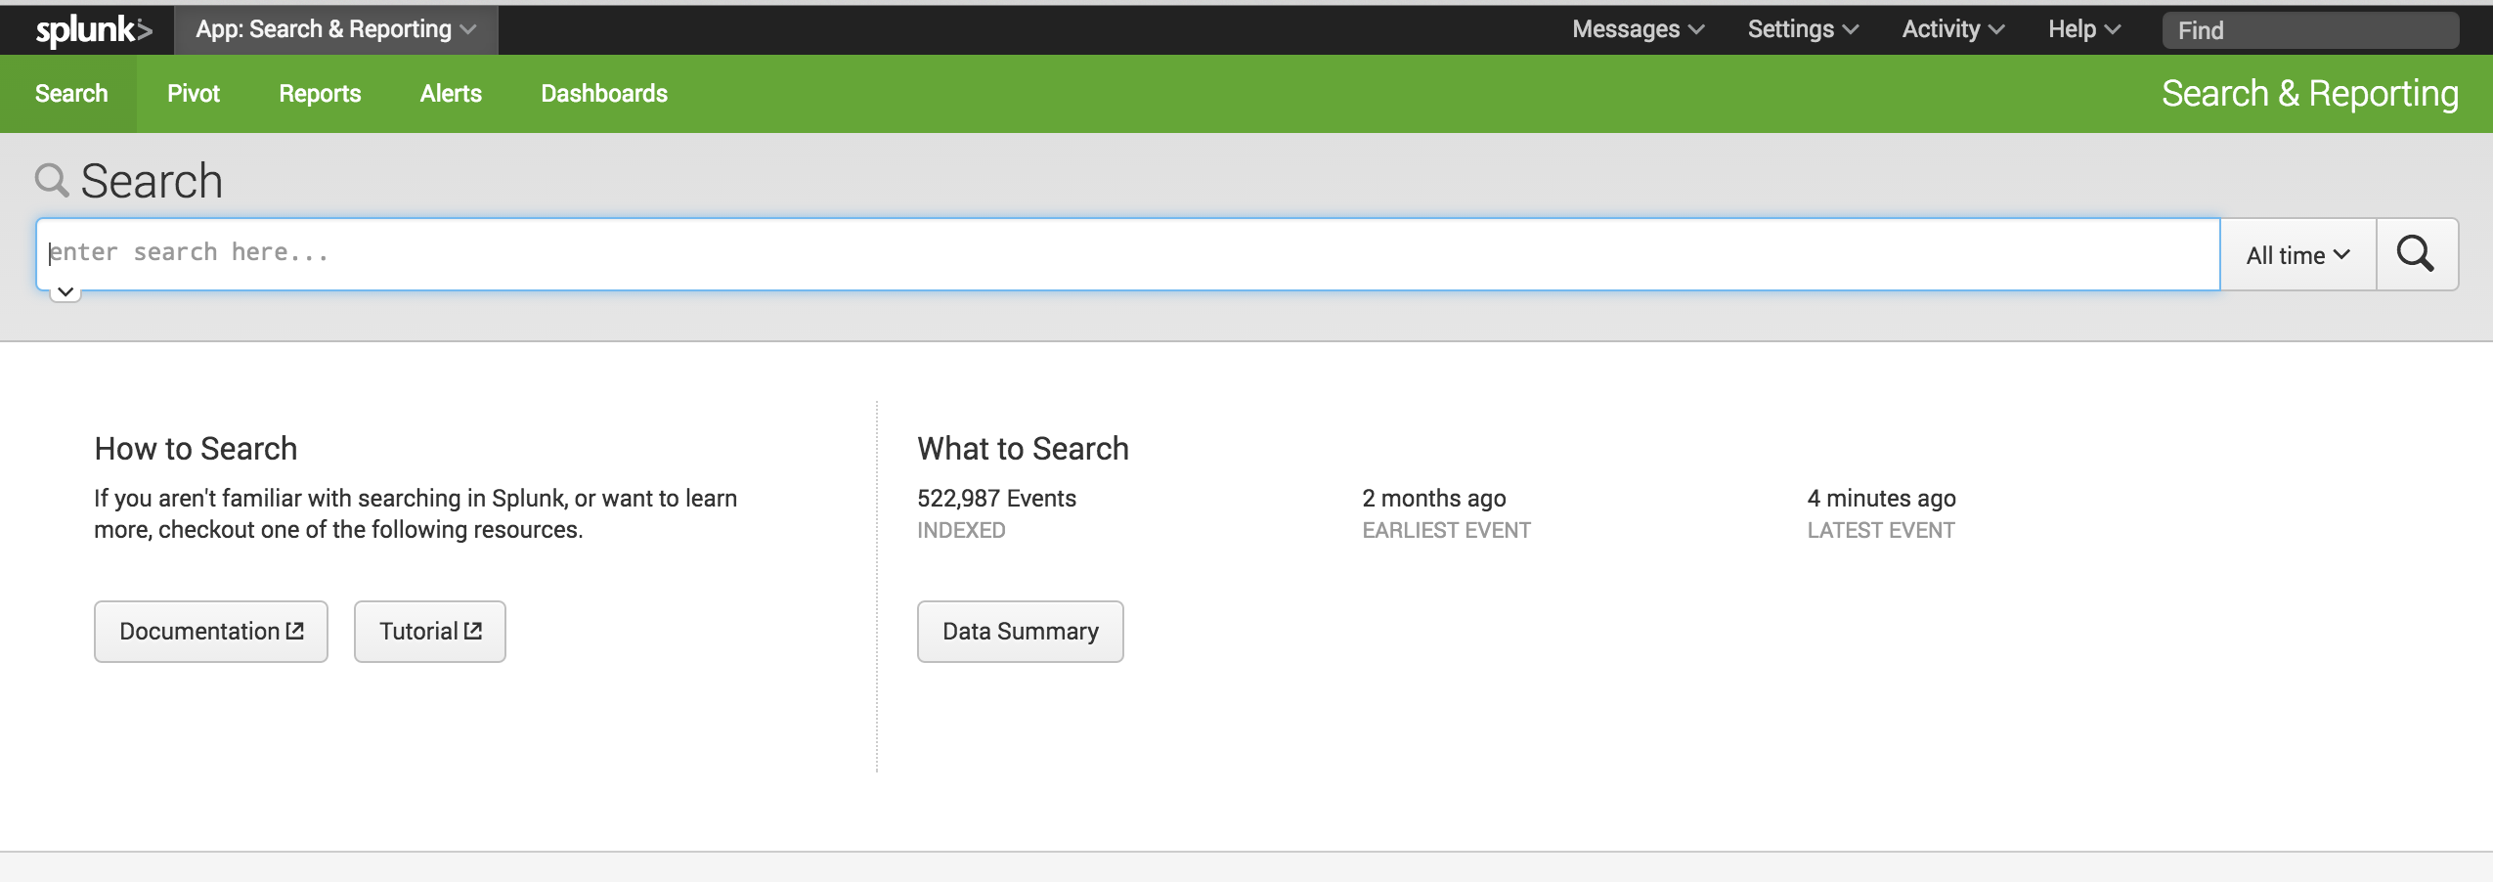
http://ubuntu.vm:9000

Slide 44
Splunk - Indexes
Splunk stores in logical “indexes”
Allows you to collect “like” logs together
Can build access restrictions around indexes
Can search/correlate across indexes (if the user has permissions)
“main” = default index
If you set this up well, nothing in there by default

Slide 45
Splunk - Events
An event is a set of values associated with a timestamp (aka a log entry)
91.205.189.15 - - [08/Jul/2015:18:22:15] "GET /category.screen?categoryId=1 HTTP 1.1" 200 1369 "http://www.google.com" "Mozilla/5.0 (Windows NT 6.1; WOW64) AppleWebKit/536.5 (KHTML, like Gecko) Chrome/19.0.1084.46 Safari/536.5" 779

Slide 46
Splunk - Host
The host is the system/device that generated the log
host = “server1”

Slide 47
Splunk - Source
The file, directory, data stream, input where the event originates from
source = “/var/log/apache2/access.log”

Slide 48
Splunk - Sourcetypes
These are the various types of data formats, used to help ID different log types from each other and slide and dice them
Tons of out of the box sourcetypes - https://docs.splunk.com/Documentation/Splunk/latest/Data/Listofpretrainedsourcetypes
Easy to add new ones yourself, via apps, etc.
sourcetype = “access_combined” (Apache logs)

Slide 49
Splunk – Fields
Key/value pairs to help distinguish events from one another and allow you very fine grained searching so you only get the specific events you want
Events are processed at search time you can you change the field extraction on the fly

Slide 50
Splunk – getting data in
Typically use Splunk Forwarder (agent) to sent logs from systems into a Splunk indexer (preferred method)
Can also syslog in to the indexer
Can also ingest local files

Slide 51
Splunk Search Processing Language
Very flexible language with hundreds of commands to process your data.
http://www.splunk.com/content/dam/splunk2/pdfs/solution-guides/splunk-quick-reference-guide.pdf

Slide 52
Splunk Searching tips
Don’t search every index if you can avoid it. (searching index=* is SLOW)
The more you can narrow down your search by time, index, sourcetype, host, etc the faster your search will run

Slide 53
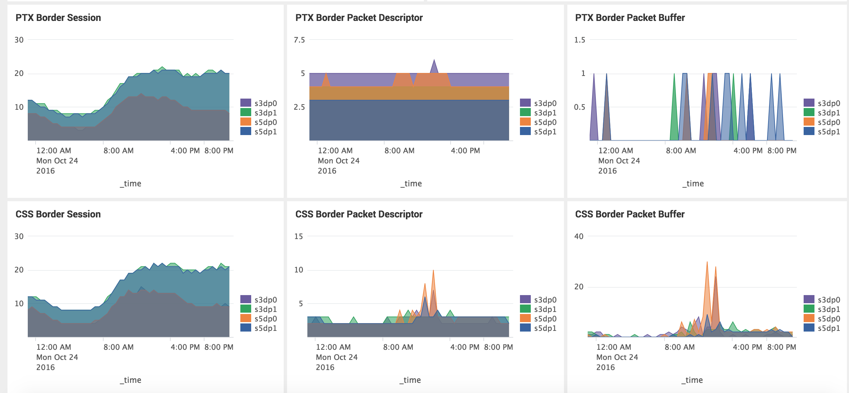

Slide 54
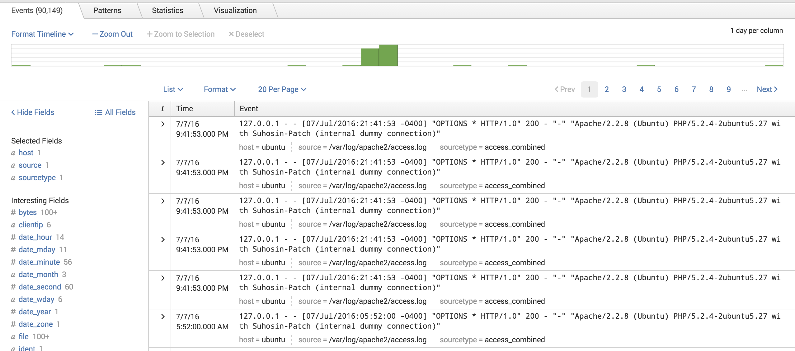
index=main sourcetype=access_combined

Slide 55
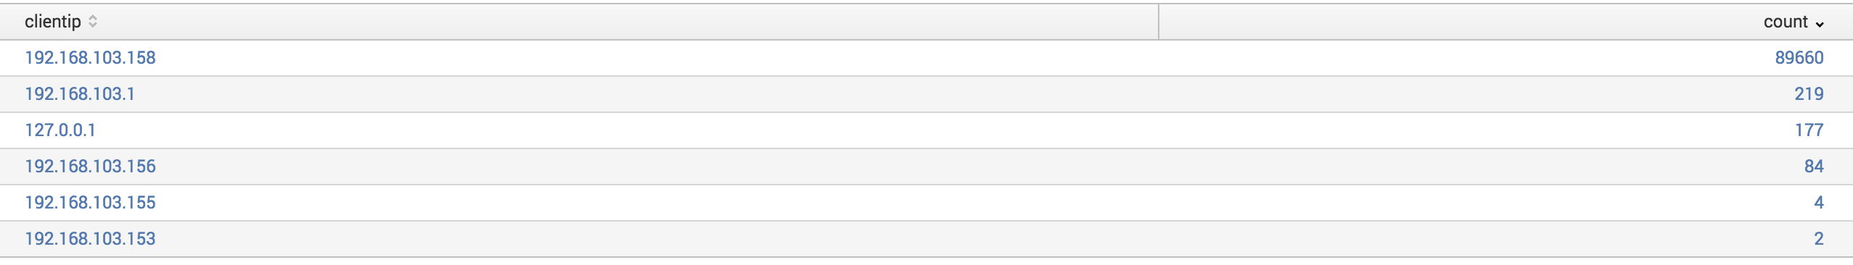
index=main sourcetype=access_combined | stats count by clientip

Slide 56
Splunk - Dashboards
A great way to visualize your data and put many things only a quick glance away

Slide 57
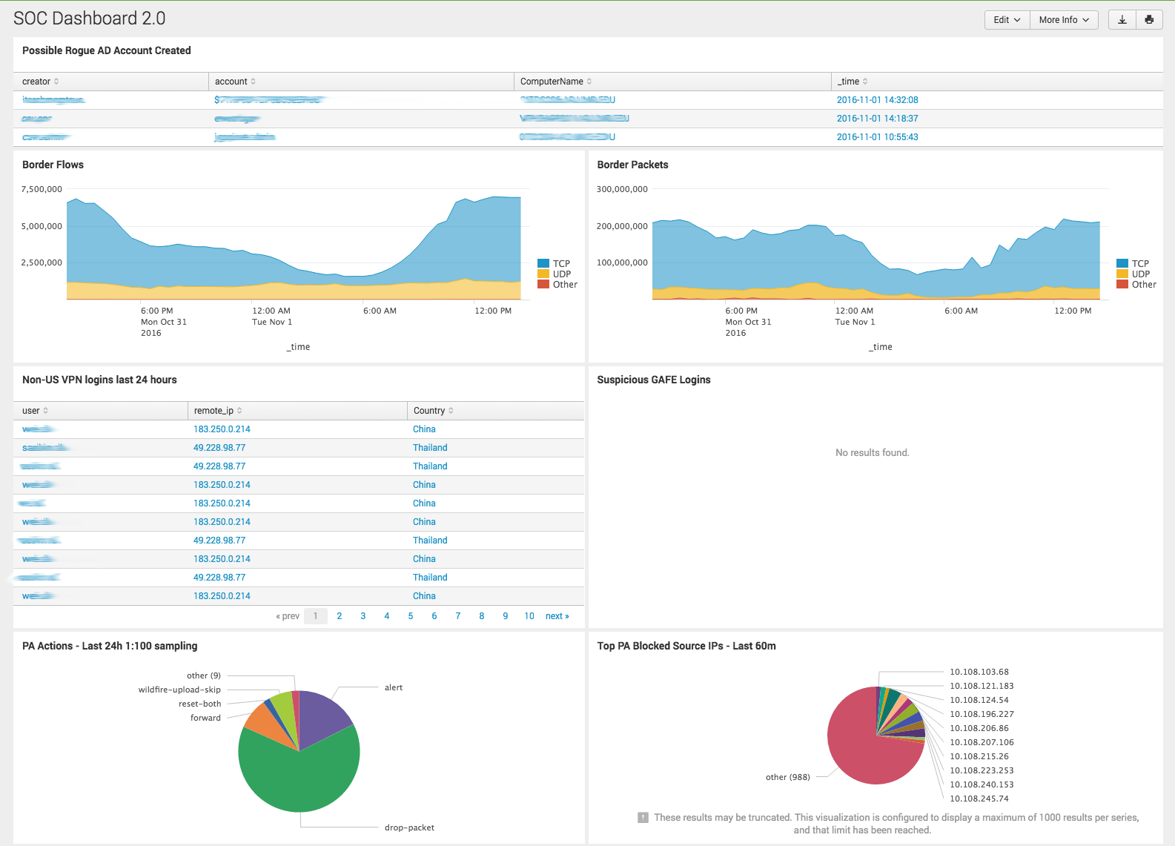

Slide 58
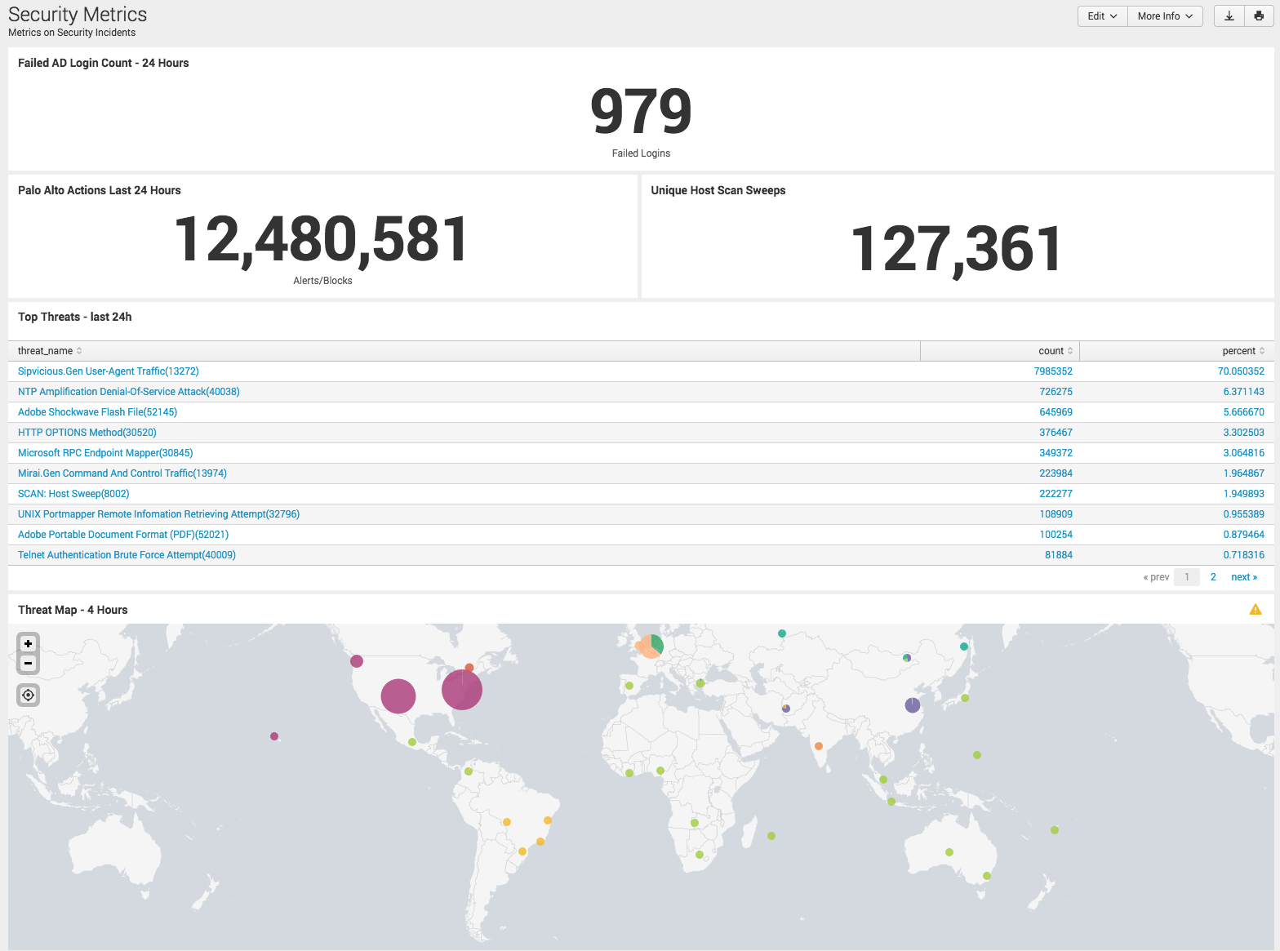

Slide 59
Splunk - Apps
Splunk can be expanded by “apps” which can provide an easier way to ingest and visualize new data
GUI/Dashboards
Behind the scenes (how to parse losts), often called Technology App ons
https://splunkbase.splunk.com/

Slide 60
Popular Apps
S.o.S – Splunk on Splunk – help debug Splunk issues
Windows Add-on – help parse Windows logs
Splunk App for AWS / Splunk Add-on for AWS – parse AWS logs
DB Connect – ingest and interact with RDMBS
Palo Alto App – parse Palo Alto NGFW logs
Enterprise Security - $ app from Splunk for managing security-related logs

Slide 61
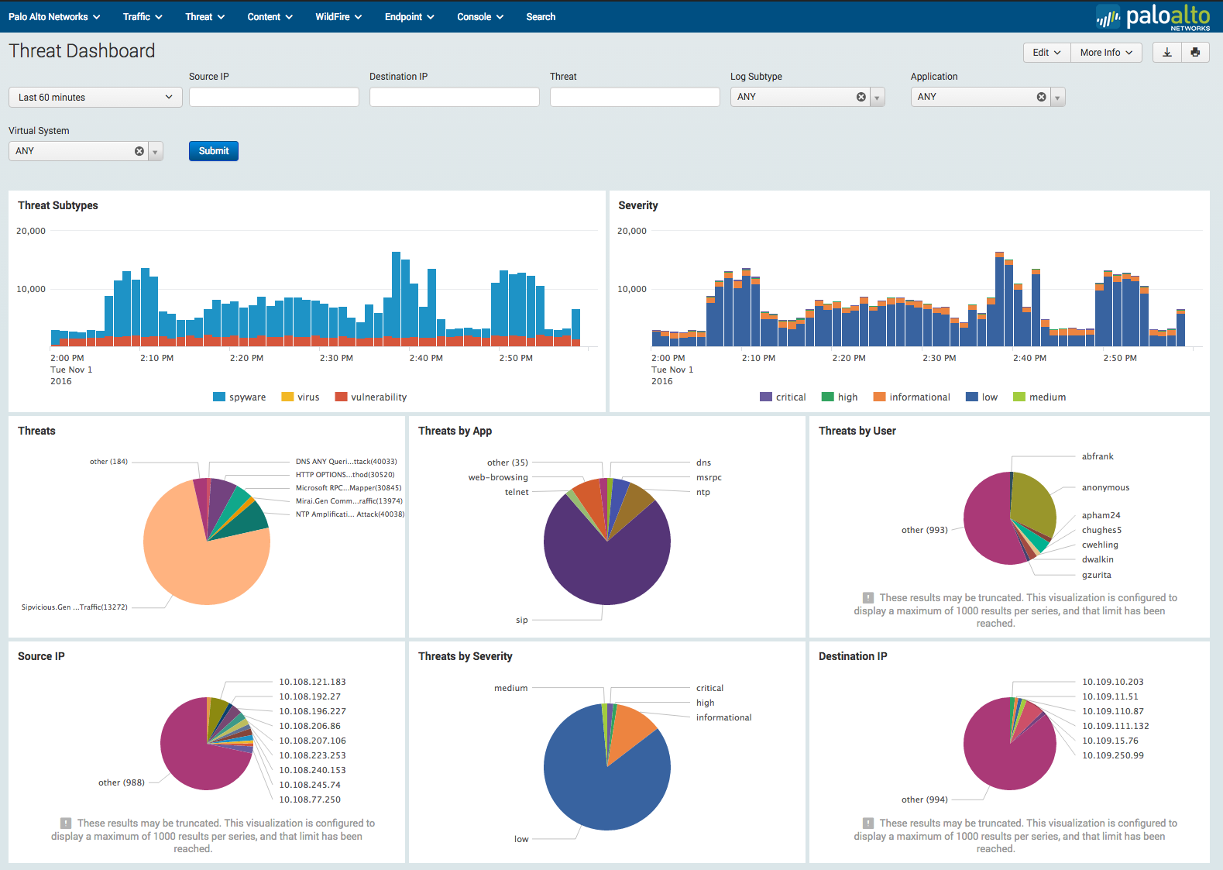

Slide 62
Splunk - Documentation
The best documentation I have found for any product online
http://docs.splunk.com/
Community Q&A – excellent resource
https://answers.splunk.com/

Slide 63
Splunk Exercise
Grab the “ENPM685-Week13-Incident-Response.pdf” document from the Files section of ELMS or the Google Drive share and complete the exercises.
We’ll spend 45 minutes on this.

Slide 64
Splunk – Free Training
The homework for this week is completing several of Splunk’s free training courses.
Complete these course and a few others (also free) then you can sit for the “Splunk Core Certified User” exam, pass the exam and you are a “Splunk Core Certified User” ($125 to sit for the exam.)
Ideally get someone else (aka an employer) to pay for the exam, but if your resume is a little thin this is something worth considering to invest in. https://www.splunk.com/en_us/training/certification-track/splunk-core-certified-user.html

Slide 65
Splunk – Learn More
By default you can index 500mb/day with a free license but lose some of the Enterprise tools
Splunk offers Academic and Developer licenses for students/faculty for educational purposes
More info: http://www.splunk.com/en_us/solutions/industries/higher-education/academic-licenses.html
https://splunkbase.splunk.com/develop/

Slide 66
Splunk – Learn More
Splunk makes a lot of their training available for free, more information and sign up is here- https://www.splunk.com/en_us/training.html
Free eLearning classes I recommend you take:
Intro to Splunk
Using Fields
Scheduling Reports and Alerts
Visualizations
Search Under the Hood

Slide 67


Slide 68
Elastic
Open source (with some commercial pieces as well as commercial support)
Written in Java ☹
“Elastic” (formerly “Elasticsearch” often refers to the full “ELK stack”

Slide 69
ELK
Elasticsearch – search layer
Logstash – log collection layer. Collects, processes, forwards logs
Kibana – presentation layer.

Slide 70
Elasticsearch
Search engine/Document indexer
Based on Apache Lucene
Written in Java
Puts everything as a JSON document
Need to get parsing and storage of documents correct, no easy way to adjust afterwards

Slide 71
Elasticsearch vs Splunk
Free(ish) vs Commercial
Stores everything as JSON. So if you’re inputting JSON your work is mostly done for you. If you’re inputting say syslog then: syslog -> JSON -> syslog for searching/presentation
Ummm?
Storage/server usage, Splunk is a bit less resource intensive
Do you want to spend your $ and time in licensing or people?
Splunk more well rounded/integrated
Elasticsearch/ELK requires you to do more heavy lifting
Coke vs Pepsi. vi vs emacs, Mac vs PC

Slide 72
Logstash
Collects, processes, forwards logs
Where you normalize logs and schemas
Takes in file input (the logs)
Grok filter to parse logs to make them structured
Elasticsearch output to then be processed by ES, Kibana, etc

Slide 73
Logstash
input {
file {
path => "/var/log/apache.log"
type => "apache-access" # a type to identify those logs (will need this later)
start_position => "beginning"
}
}

Slide 74
Logstash - grok
https://www.elastic.co/guide/en/logstash/current/plugins-filters-grok.html
“Grok is currently the best way in logstash to parse crappy unstructured log data into something structured and queryable.”
o_O
~120 patterns by default

Slide 75
Logstash - grok
filter {
grok {
match => { "message" => "%{IP:client} %{WORD:method} %{URIPATHPARAM:request} %{NUMBER:bytes} %{NUMBER:duration}" }
}
}

Slide 76
Kibana
Visualization piece of ELK stack
No authentication by default
Utilize a proxy of some kind or pay for Shield

Slide 77
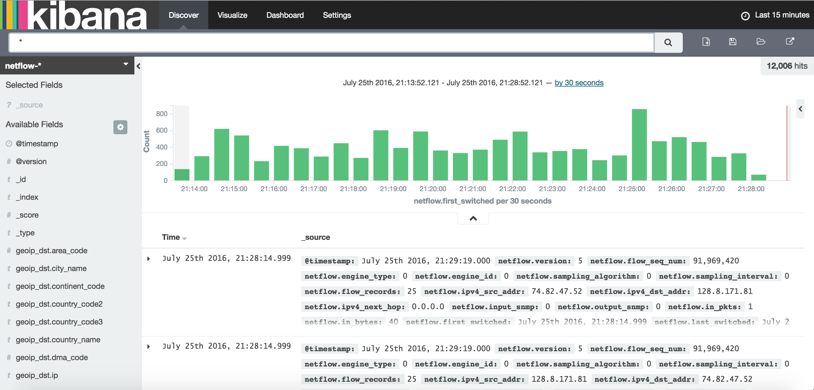

Slide 78
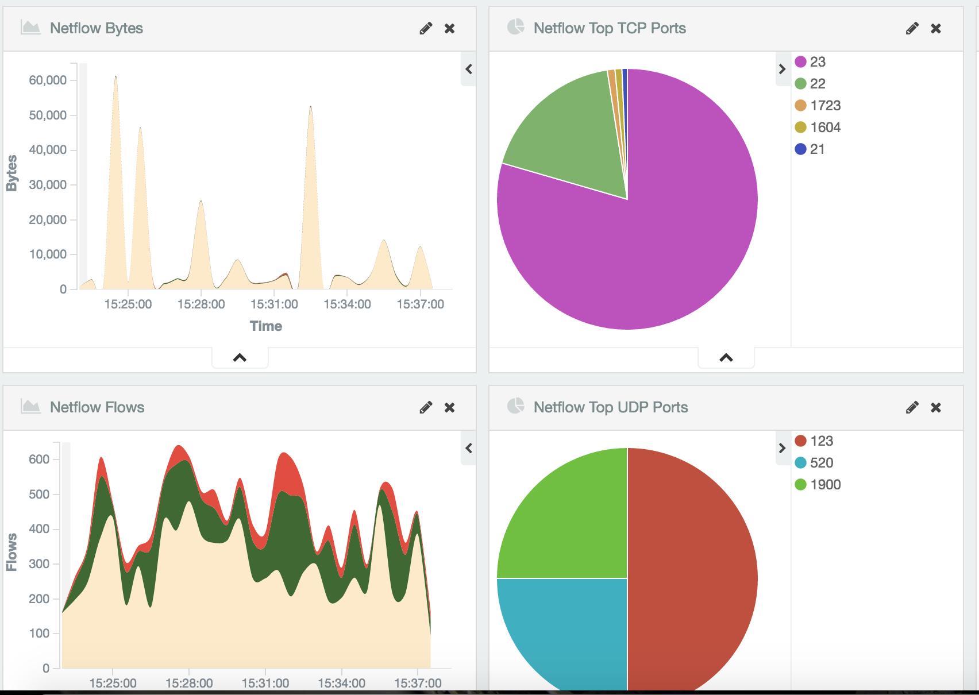

Slide 79
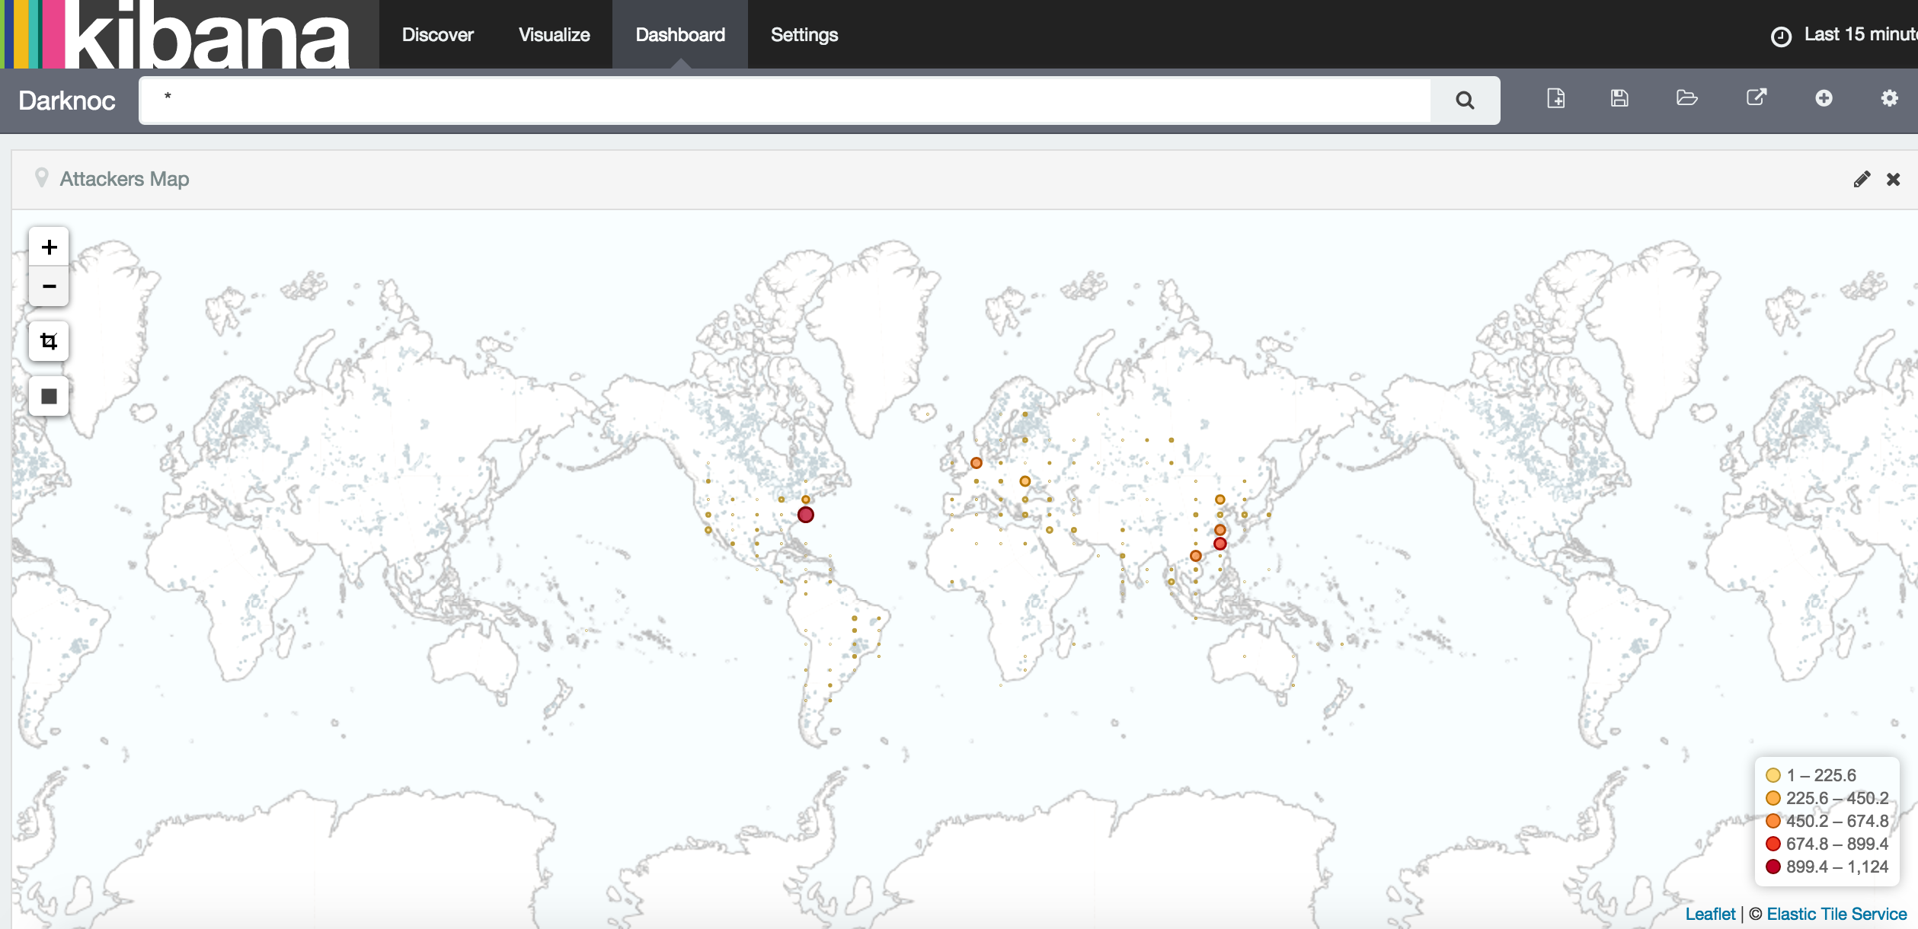

Slide 80
Elastic – No security by default
https://www.elastic.co/blog/found-elasticsearch-security
“Elasticsearch does not perform authentication or authorization, leaving that as an exercise for the developer.”
“Elasticsearch has no concept of a user. Essentially, anyone that can send arbitrary requests to your cluster is a “super user”.”
It’s not a bug, it’s a feature!

Slide 81
Elasticsearch Shield
Commercial product
Offers authentication for ES + Kibana
Login & session mgmt
Role-based access control
Field/Document level security
TLS encryption over the wire
Log all the things
$1600/year/cluster

Slide 82
Filebeat
Tool to ship logs from hosts into your Elastic Search cluster
Currently only supports
Linux
Windows (Winlogbeat for Windows Event logs, Filebeat for regular files)
OSX
Packetbeat for “live packet data”

Slide 83
GreyLog2
https://www.graylog.org/
https://github.com/Graylog2/graylog2-server
Similar to ELK
Sidecar – app to configure nxlog/fluentd/logstash to send logs to Greylog

Slide 84
Loggly
Essentially Elasticsearch as a Service

Slide 85
Beyond Simple Collection
Log Aggregation is great
Analysis and Correlation is better

Slide 86
Alert Fatigue
When an overwhelming number of alerts prohibits or desensitizes the people tasked with responding to alerts, leading to missed or ignored alerts or delayed responses.
People side – not enough staff to process incoming alerts
Technology side
Low-fidelity alerts - over-alerting on benign activity (ex: low quality IP threat list adds “8.8.8.8” due to malware checking it for internet connectivity)
Overly aggressive thresholding (“RDP brute forcing attempt!” after a user ”fat fingered” their password 3 times)

Slide 87
GRIZZLY STEPPE Threat Intel
https://us-cert.cisa.gov/GRIZZLY-STEPPE-Russian-Malicious-Cyber-Activity
Included in this is threat intel in CSV/STIX which includes ~876 IP addresses
44 Public Tor nodes
4 Yahoo mail servers
“Yahoo servers, the Tor network, and other targets of the DHS list generate reams of legitimate traffic, and an alarm system that’s always ringing is no alarm system at all.” – Kevin Poulsen
https://www.thedailybeast.com/how-the-us-hobbled-its-hacking-case-against-russia-and-enabled-truthers

Slide 88
Realistic Alert/Incident Review
How many alerts can an analyst review in an 8 hour work day?
How much of that day is actually spent on alert review?
Some research claims only 3 hours/day
https://www.inc.com/melanie-curtin/in-an-8-hour-day-the-average-worker-is-productive-for-this-many-hours.html (3 hours/day of real work)
I will say 5 hours/day (taking out time for breaks, checking email/social media/reddit, SQUIRREL, bathroom breaks, etc.)
Notes:
https://www.inc.com/melanie-curtin/in-an-8-hour-day-the-average-worker-is-productive-for-this-many-hours.html (3 hours/day of real work)
The most popular unproductive activities listed were:
Reading news websites--1 hour, 5 minutes
Checking social media--44 minutes
Discussing non-work-related things with co-workers--40 minutes
Searching for new jobs--26 minutes
Taking smoke breaks--23 minutes
Making calls to partners or friends--18 minutes
Making hot drinks--17 minutes
Texting or instant messaging--14 minutes
Eating snacks--8 minutes
Making food in office--7 minutes

Slide 89
Realistic Alert/Incident Review
How long does it take to review an alert to determine if it is an incident and triage that incident?
Simple alert/false positive – 15 minutes?
More in-depth alert/low level incident with a simple fix – an hour?
Complex medium level incident ?
Highly complex incident – 2 weeks?
Add probability the probability of each of these happening
There will never been enough analysts to review all your alerts

Slide 90
Data Normalization
All of these are (often) the same thing!
src_ip
source_ip
s.ip
source
clientip
Normalize these fields and it is much easier to correlate logs across different systems and services

Slide 91
Data Normalization Methods
Common Information Model (CIM) - Splunk’s method to normalize data fields across different log types
https://docs.splunk.com/Documentation/CIM/4.20.2/User/Overview
Elastic Common Schema (ECS) – Elastic’s method to normalize data fields
https://www.elastic.co/guide/en/ecs/current/index.html

Slide 92
Security Information and Event Management
SIEM for short
SIEM/SEIM/SIM/SEM/SIEM-E-I-E-I-O
Data Aggregation
Correlation
Alerting

Slide 93
More SIEM Features
Dashboards
Compliance assistance
Log retention

Slide 94
Sample Commercial Products
Splunk (Enterprise Security app/roll your own)
Elastic
IBM (Q1 Labs)
HP (ArcSight)
McAfee/Intel
LogRhythm (Boooooooooooo)
Solarwinds
AlienVault

Slide 95
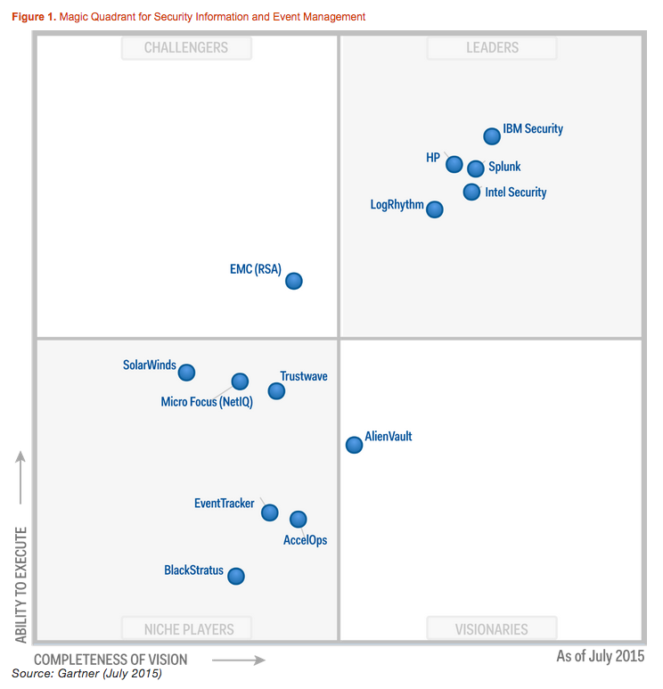

Slide 96
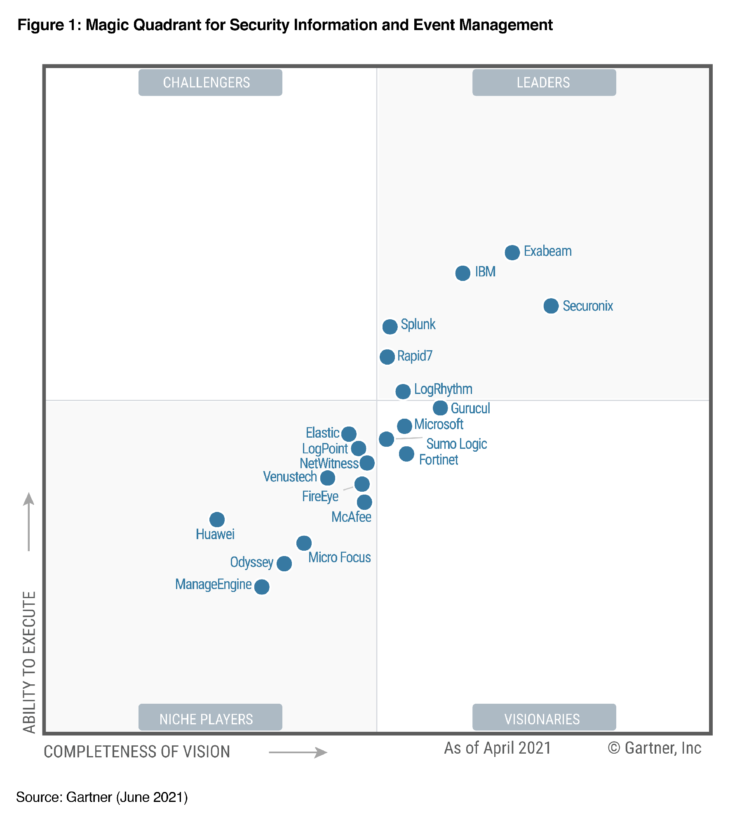

Slide 97
OTX – Open Threat Exchange
https://www.alienvault.com/open-threat-exchange
https://otx.alienvault.com/
Open Source listing of threat data
IP addresses
DNS names
URLs
Email addresses
File hashes

Slide 98
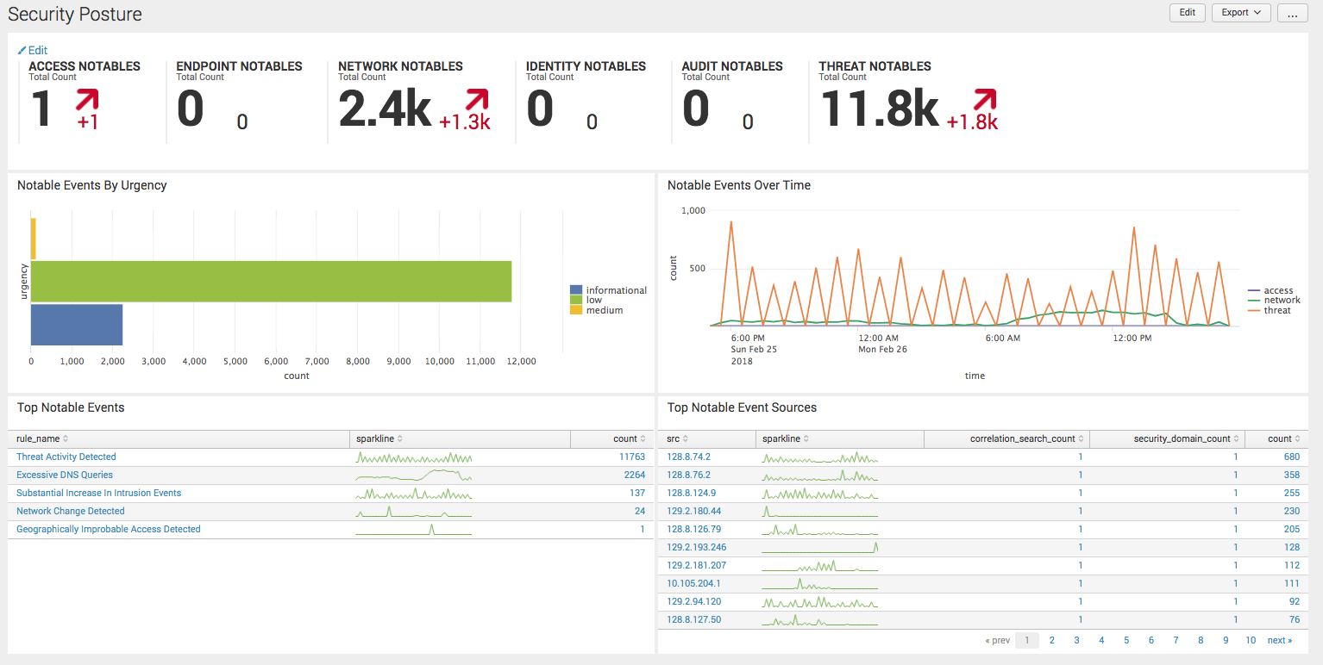
Splunk Enterprise Security

Slide 99
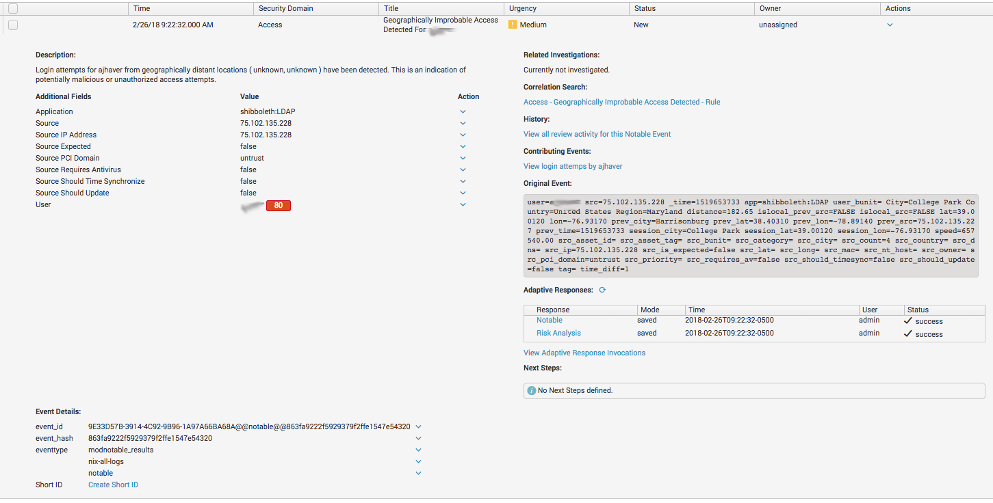
Splunk Enterprise Security

Slide 100
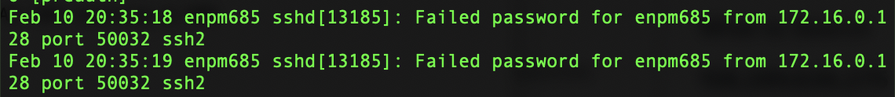
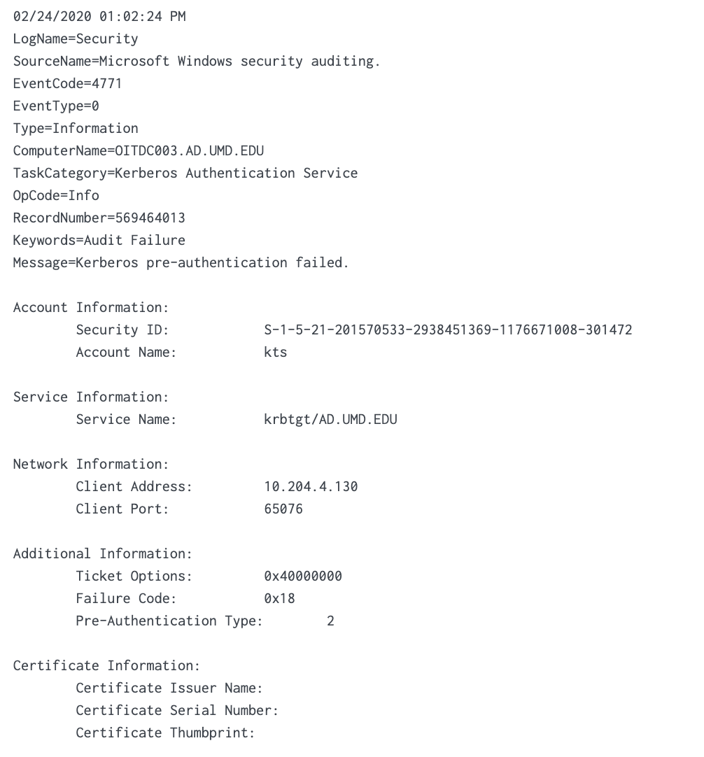
Data Models Data Abstraction

Slide 101
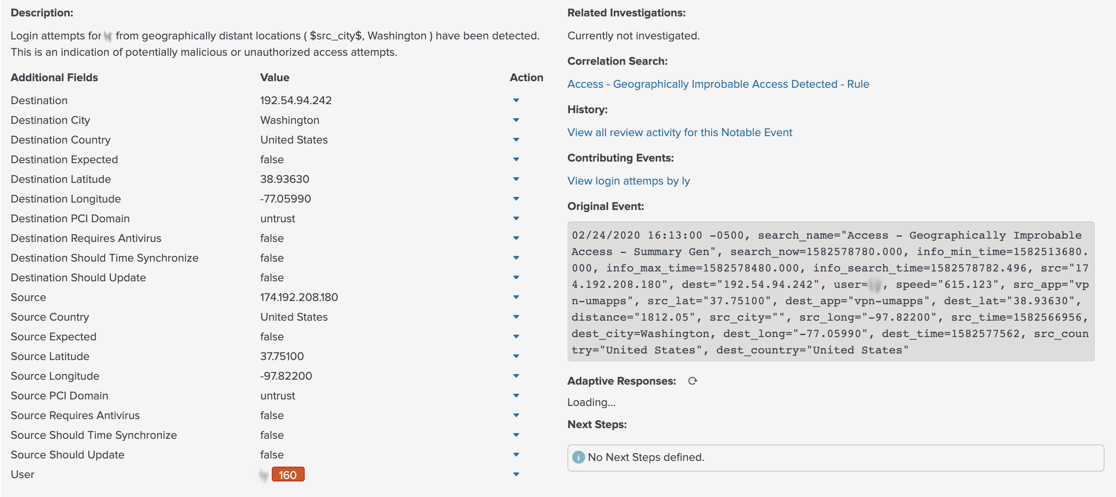
192.54.94.242 = umd-guest IP
174.192.208.180 = 180.sub-174-192-208.myvzw.com
Speed ~615mph!

Slide 102
Homework #7
Complete the following Splunk training courses:
Intro to Splunk
Using Fields
Visualizations
Intro to Dashboards
These are free and online eLearning. Links in the Homework document

Slide 104

THE FINAL

Slide 105
Final
ENPM685 Waffle Co is a small food tech start up
One of their development systems is believed to be compromised
The DBA, Julia, discovered that she would could not login to the system and contacted the web dev/sysadmin Nathan.
Soon after a Pastebin link talking about the company being hacked was anonymously emailed to Nathan

Slide 106
Final
Your mission is to analyze the supplied files (logs, user files, and a packet capture) to discover
If it was compromised
If compromised, how the attacker got in and what they did.
Use your skills learned so far (and more you’ll pick up over these next few weeks) to answer this and write an attack narrative.
Due Friday May 16th@11:59pm

